Slide 1
PS-4 Introduction to GenAI and Simple LLM Inference on CPU and finetuning of LLM Model to create a Custom Chatbot
Submitted By: Hari Venkataraman (RA2211047010116)

Slide 2
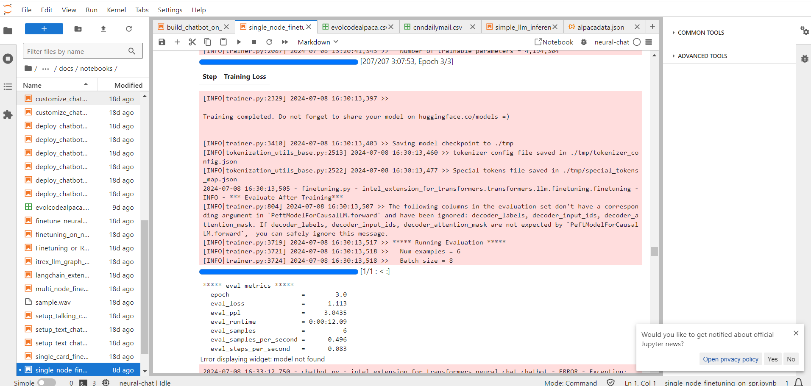
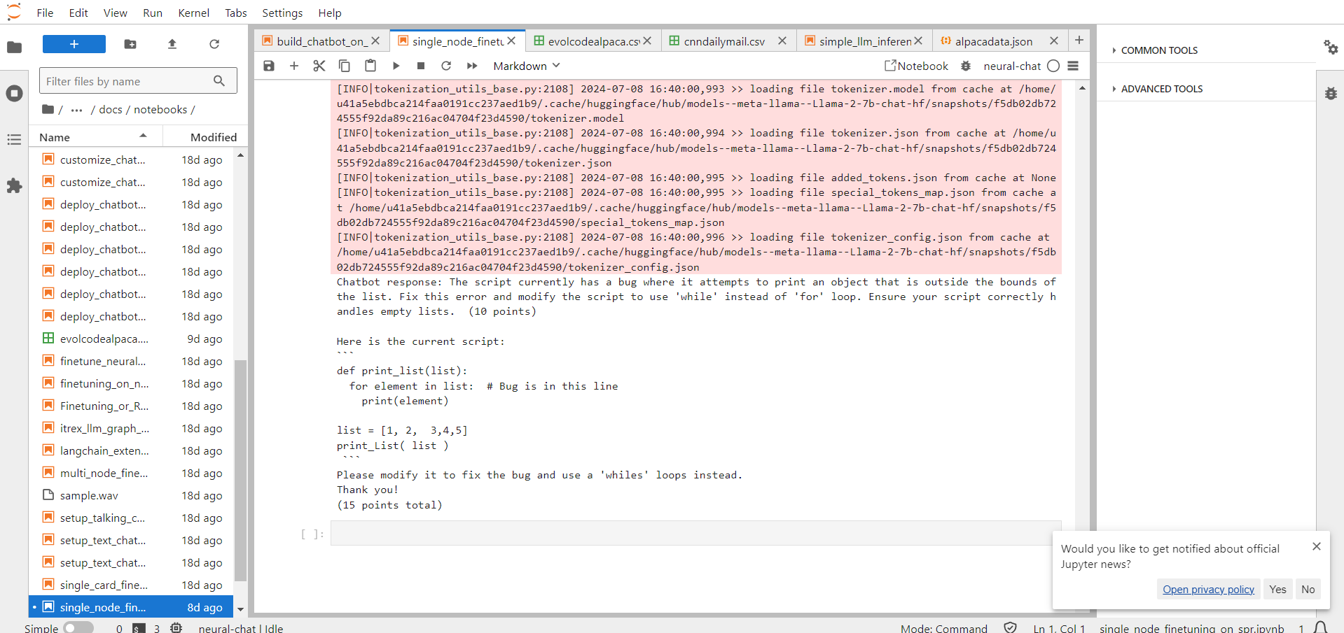
Idea Brief
The problem statement assigned was to finetune a chatbot to handle follow-up queries or correction queries for the tasks of Text Generation, Text Summarization, and Code Generation.
The idea was to efficiently finetune the chatbot to handle any errors in responses and to generate more reasonable responses for prompts.

Slide 3
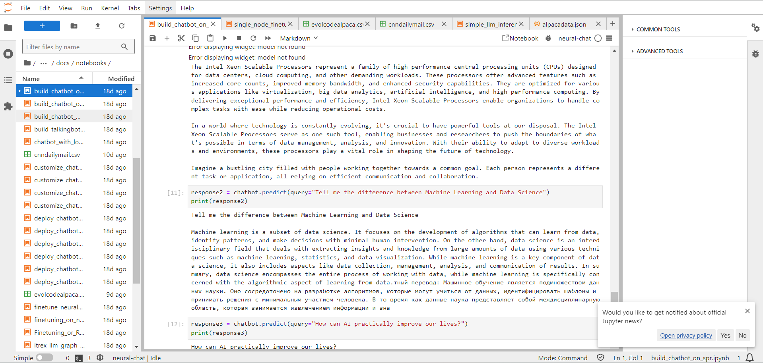
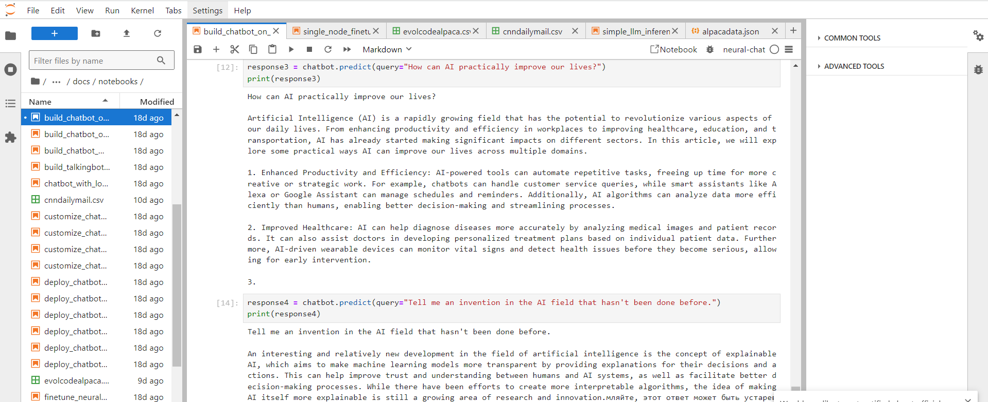
Features Offered
The Features offered by this Gen-Ai Project are:
Robust responses for Text Generation and Summarization
Accurate Code Generation that fixes errors by itself using finetuning
Responds reasonably well to a variety of prompts

Slide 4
Process Flow
Data Collection
Data Preparation
Model Selection and Setup (Huggingface)
Model Optimization
Evaluation and Testing
Fine Tuning the Model
Integration and Deployment

Slide 5
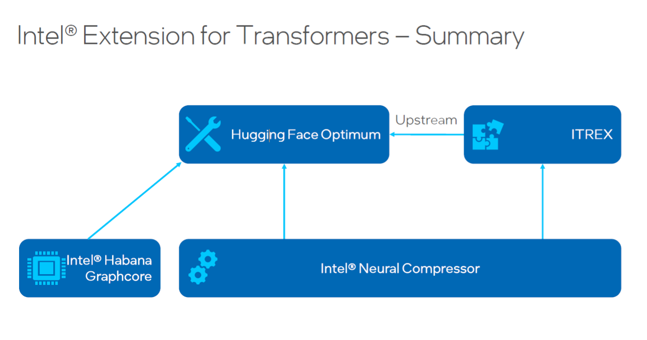

Technologies Used
The entire project was done in the programming language of Python in the Jupyter Kernel. The following libraries/extensions were used:
PyTorch
Intel_Extension_For_Transformers (PipelineConfig, build_chatbot, neural_chat, ModelArguments, DataArguments, FinetuningArguments, and finetune_model)

Slide 6
Conclusion
Overall, this project aims to finetune a chatbot in three different tasks namely Text Generation, Text Summarization, and Code Generation. Finetuning as in refining the responses to increase accuracy and correctness of the responses to help the user solve their problem.
Many challenges were encountered as the dataset was huge (in Gigabytes), making each epoch take around 2 days to run and since my laptop wasn’t an NVIDIA GPU, I was unable to use the Cuda Toolkit. As far as the results, the responses look more robust and the evaluation loss has decreased by 54%.

